Slide 1

A gamified introduction to Python Programming Lecture 9 About recursion and decorators
Matthieu DE MARI – Singapore University of Technology and Design

Slide 2

Outline (Chapter 9)
What is recursion in programming?
How can recursion be used as an alternative to looping?
What is the LRU cache decorator and its purpose?
How to measure the performance of functions?
What is a decorator anyway?
Some practice on recursion.

Slide 3
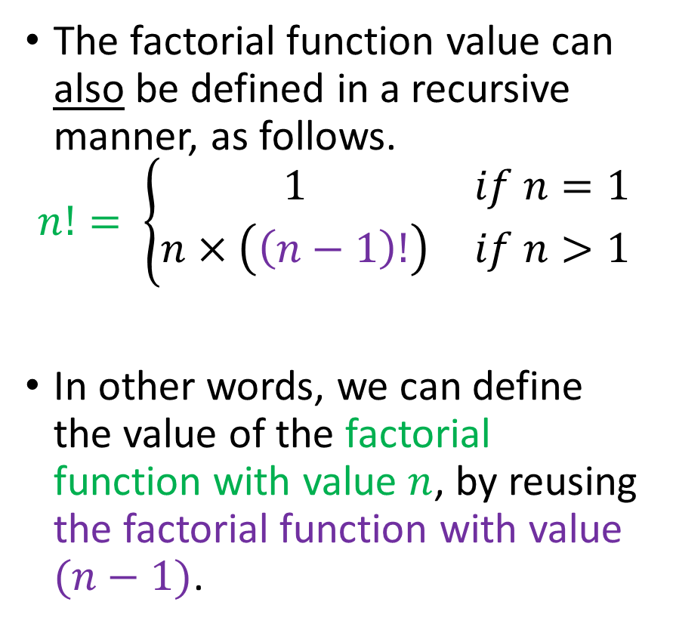
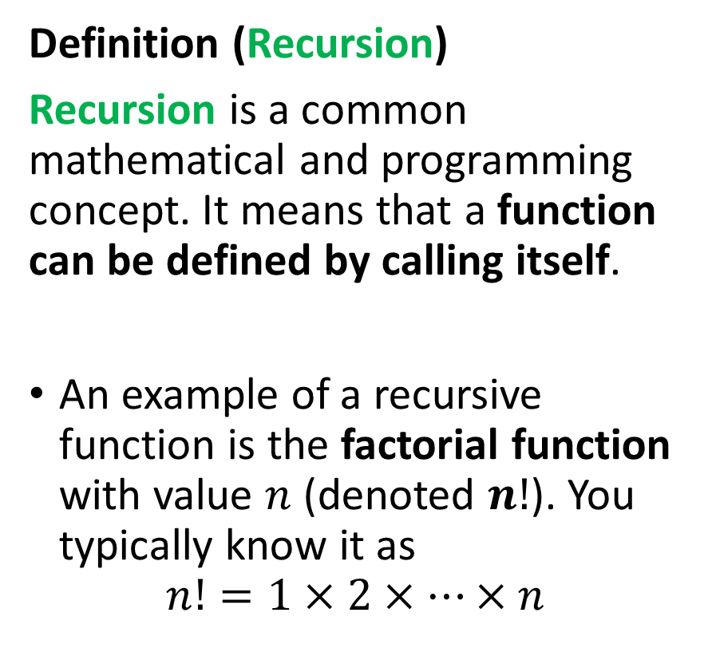
Recursion: definition
Definition (Recursion)
Recursion is a common mathematical and programming concept. It means that a function can be defined by calling itself.
An example of a recursive function is the factorial function with value $n$ (denoted $n!$). You typically know it as
$$n!=1×2×…×n$$
The factorial function value can also be defined in a recursive manner, as follows.
$$n!= \left\{\begin{matrix}1 & if n=1 \\ n×\left(\left(n−1\right)!\right) & if n>1\end{matrix}\right.$$
In other words, we can define the value of the factorial function with value $n$, by reusing the factorial function with value $(n−1)$.

Slide 4
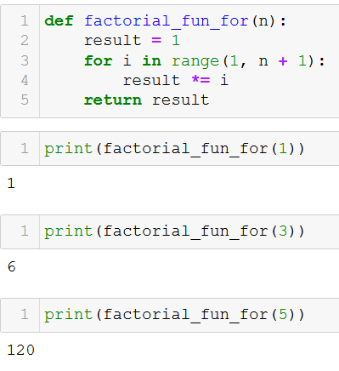
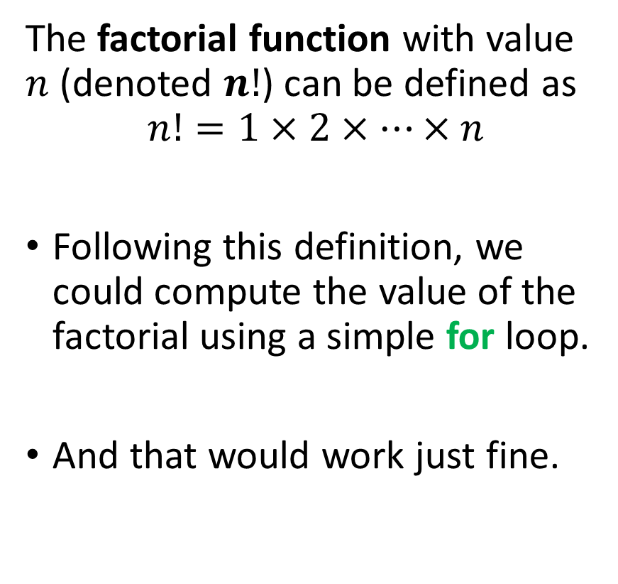
Recursion vs. for loop
The factorial function with value $n$ (denoted $n!$) can be defined as
$$n!=1×2×…×n$$
Following this definition, we could compute the value of the factorial using a simple for loop.
And that would work just fine.

Slide 5
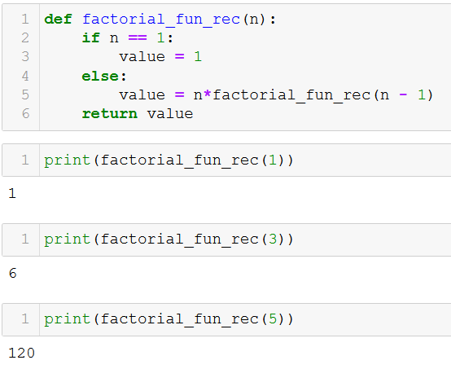
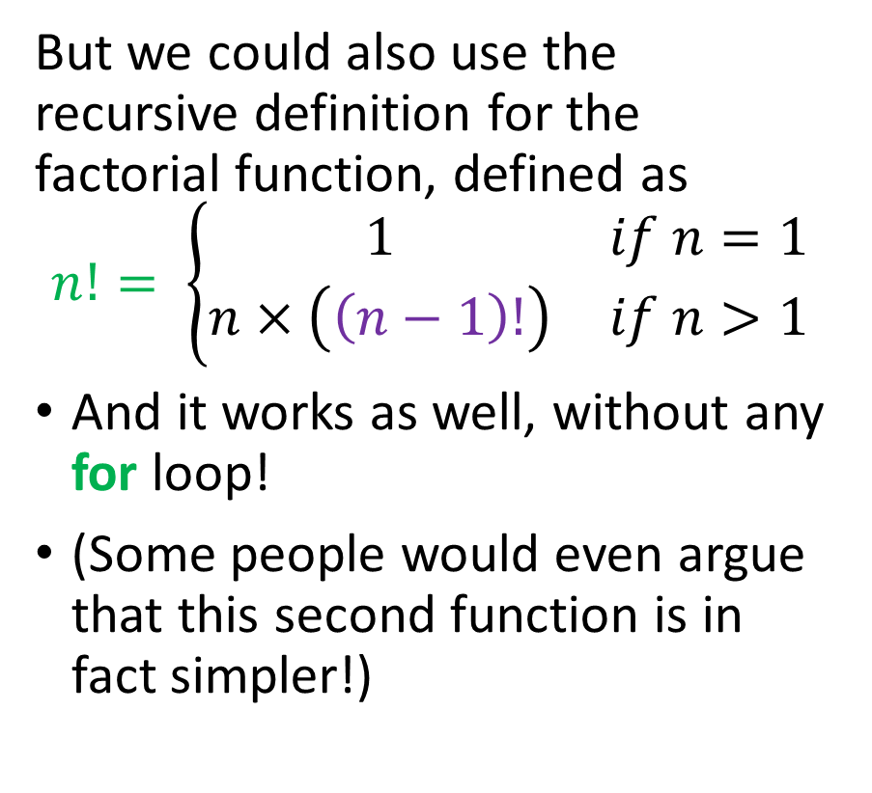
Recursion vs. for loop
But we could also use the recursive definition for the factorial function, defined as
$$n!= \left\{\begin{matrix}1 & if n=1 \\ n×\left(\left(n−1\right)!\right) & if n>1\end{matrix}\right.$$
And it works as well, without any for loop!
(Some people would even argue that this second function is in fact simpler!)

Slide 6
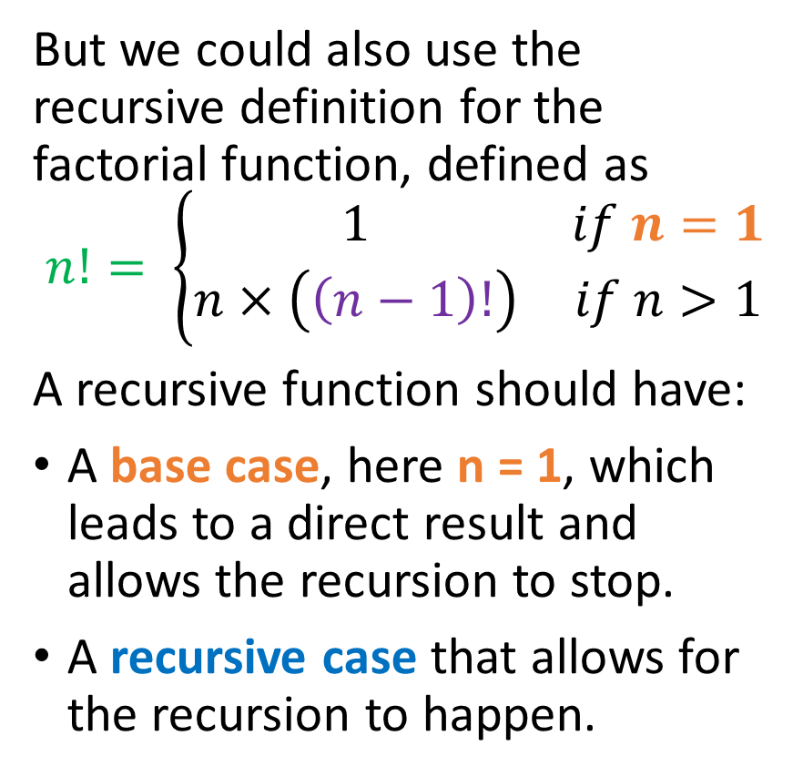
Recursion vs. for loop
But we could also use the recursive definition for the factorial function, defined as
$$n!= \left\{\begin{matrix}1 & if n=1 \\ n×\left(\left(n−1\right)!\right) & if n>1\end{matrix}\right.$$
A recursive function should have:
A base case, here n = 1, which leads to a direct result and allows the recursion to stop.
A recursive case that allows for the recursion to happen.

Slide 7
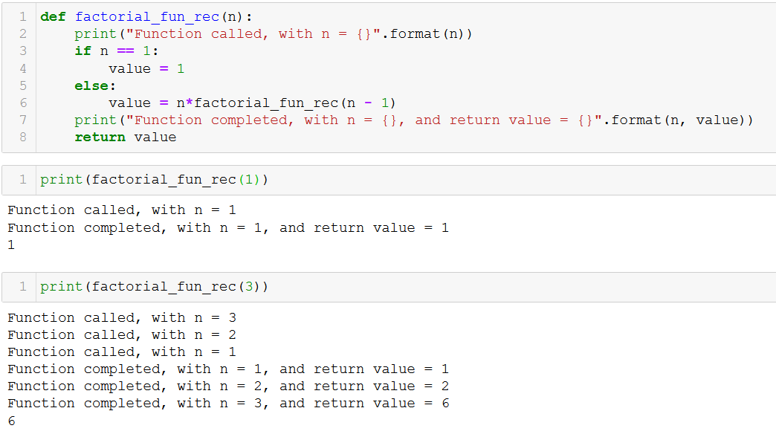
Recursion vs. for loop
What happens in practice? Multiple concurrent runs of a function.

Slide 8
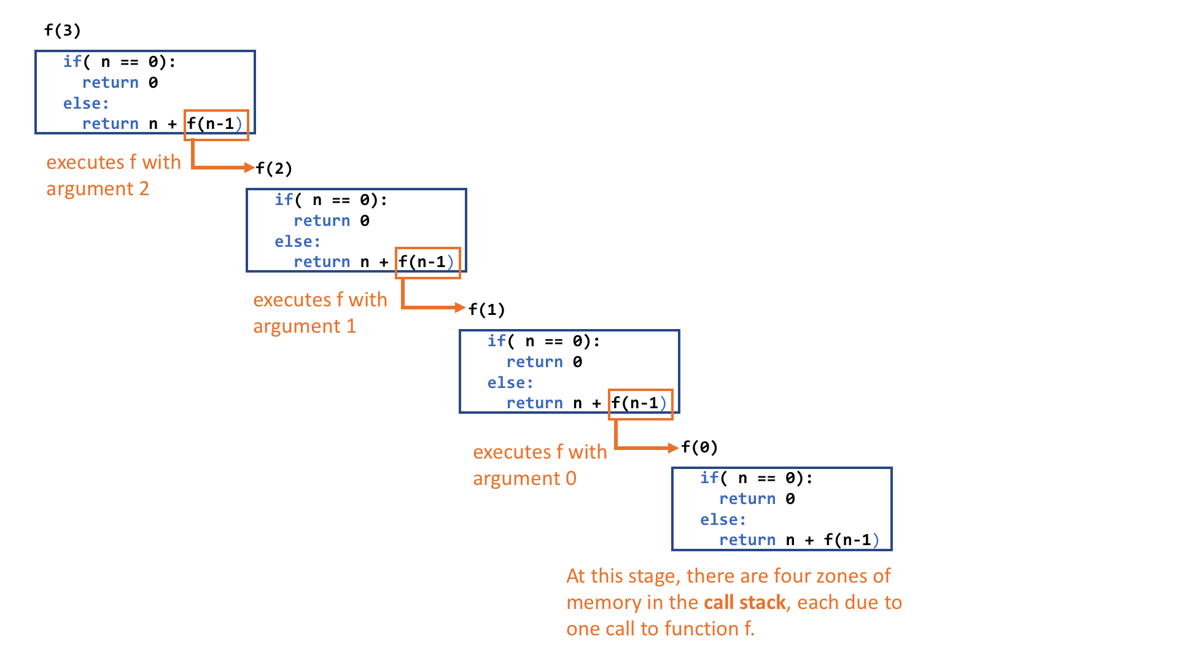
Recursion vs. for loop
What happens in practice? Multiple concurrent runs of a function.
Forward pass for the recursion:
Each blue square is a separate function call,
The function call for f(3) is paused as we need to resolve f(2) first.
Same with f(2) and f(1)

Slide 9
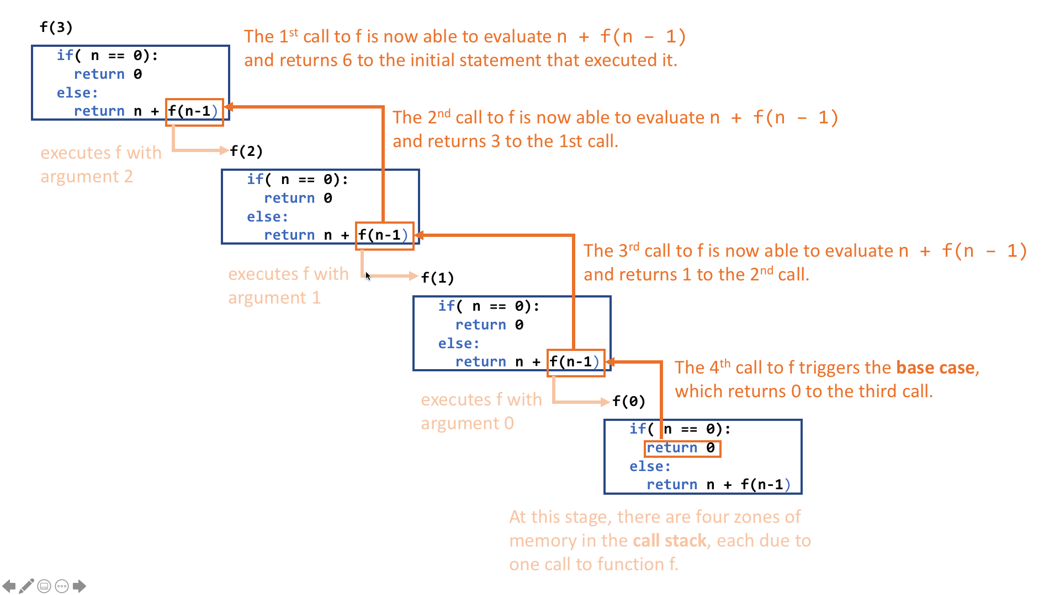
Recursion vs. for loop
What happens in practice? Multiple concurrent runs of a function.
Backward pass for the recursion, resolves paused functions in reverse from f(0) to f(3).

Slide 10
Recursion vs. for loop
Recursion is an interesting trick for computing the value of a function, which would normally require an iterative for loop.
In some cases, recursion might be faster than an iterative for loop.
Sometimes it is not.
→ Something we will discuss once we investigate computational complexity (a.k.a. the science of designing the best code for a task)

Slide 11
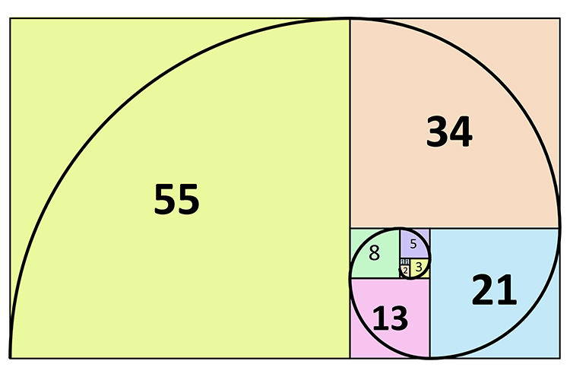
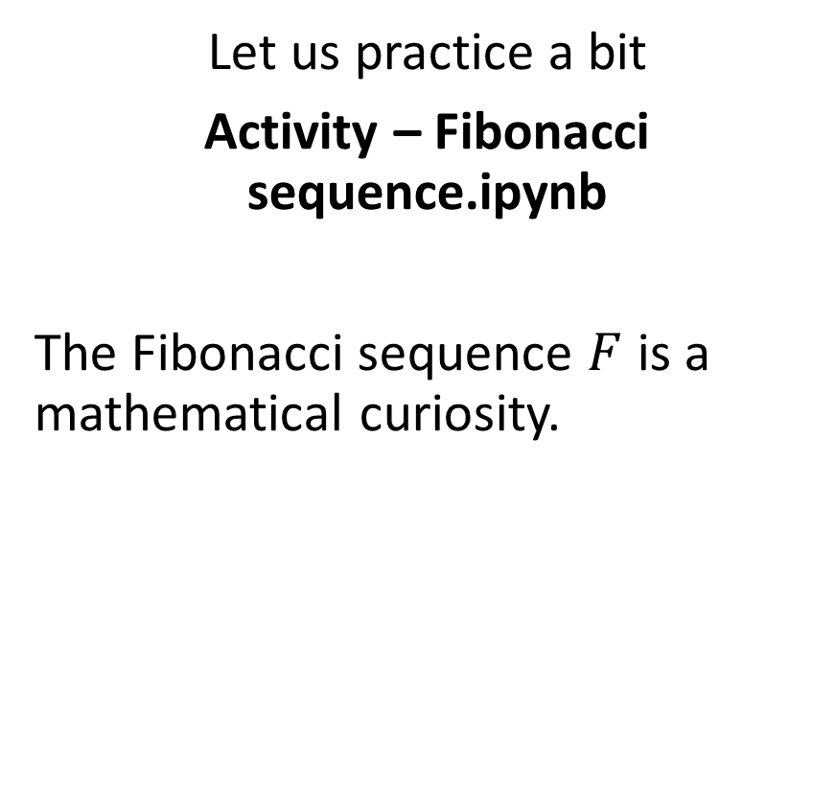
Practice activities: recursion vs. for loops
Let us practice a bit
Activity – Fibonacci sequence.ipynb
The Fibonacci sequence $F$ is a mathematical curiosity.

Slide 12
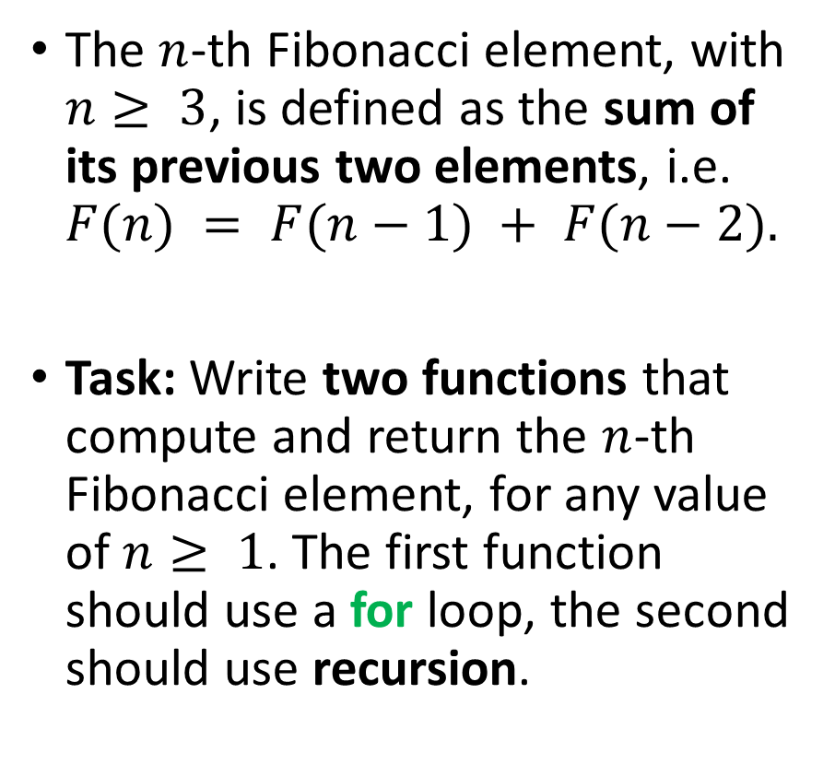
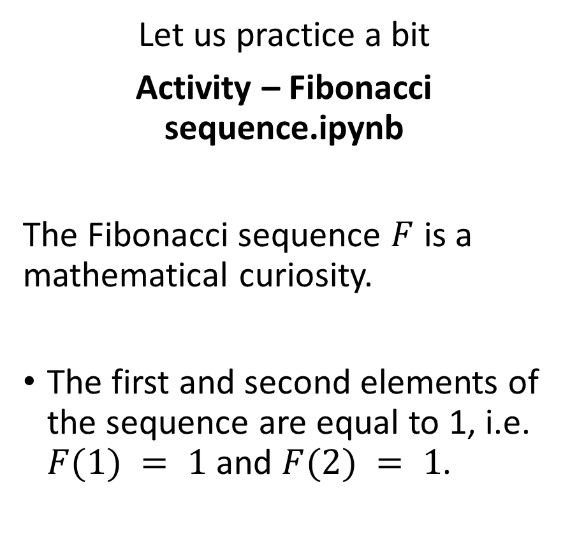
Practice activities: recursion vs. for loops
Let us practice a bit
Activity – Fibonacci sequence.ipynb
The Fibonacci sequence $F$ is a mathematical curiosity.
The first and second elements of the sequence are equal to 1, i.e. $F(1) = 1$and $F(2) = 1$.
The $n$-th Fibonacci element, with $n≥ 3$, is defined as the sum of its previous two elements, i.e. $F(n) = F(n−1) + F(n−2).$
Task: Write two functions that compute and return the $n$-th Fibonacci element, for any value of $n≥ 1$. The first function should use a for loop, the second should use recursion.

Slide 13
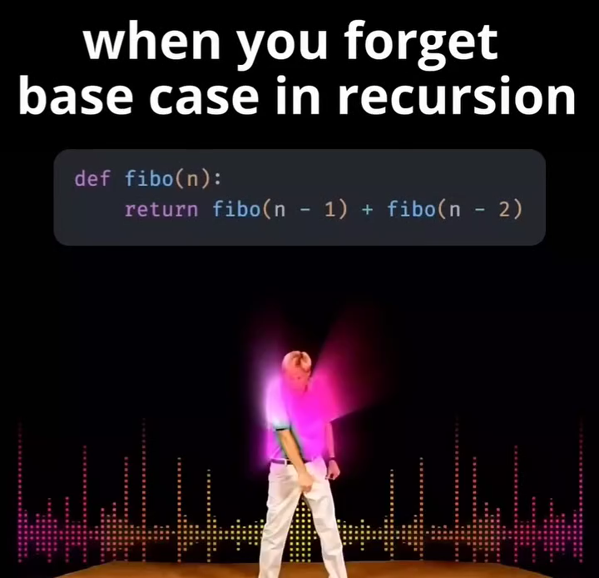
Some typical mistakes with recursion
Typical beginner mistakes with recursion include:
Forgetting the base case,
Writing a recursive design that does not end up being resolved by the base case at some point. (This means the forward pass never reaches an end and you are stuck with an infinite loop!)
Careful with your function design!

Slide 14
Completely out-of-scope
For those of you who like pain and want to see stuff from Term 3.

Slide 15
What makes a good function?
Definition (a “good” function?): We can define a ”good” function as
A function that is able to operate on any of its “normal” test cases. (In the case of a function whose job is to find average value of a list, a normal case consists of a list containing one or more integers)
A function that is able to cover for special cases. (What happens to our function if we use an empty list? Cases where a division by zero occurs? Etc. Should it return a None in these cases? An empty list? Etc. Should it refuse to operate and produce an error message?)
A function that produces results as fast as possible! (Measure it!)

Slide 16
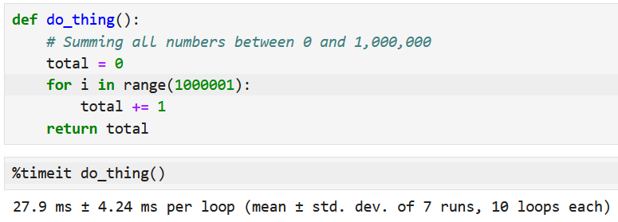
iPython Magic Commands
Definition (iPython Magic Commands):
In Jupyter Notebooks, magic commands are special commands that are not a part of the Python language itself but are provided by the iPython/Notebook environment. Magic commands are prefixed with percentage signs (% or %%) and are used to perform various operations.
For instance, we can use the %timeit magic command to measure how much time our functions take to run, and compare different designs!

Slide 17
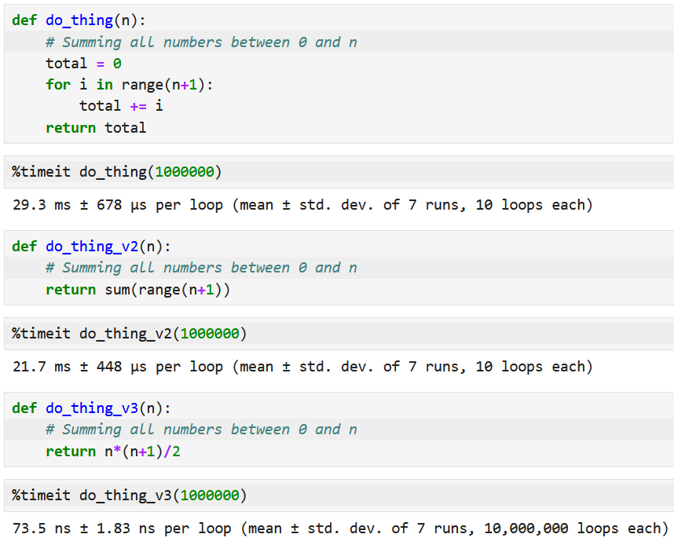
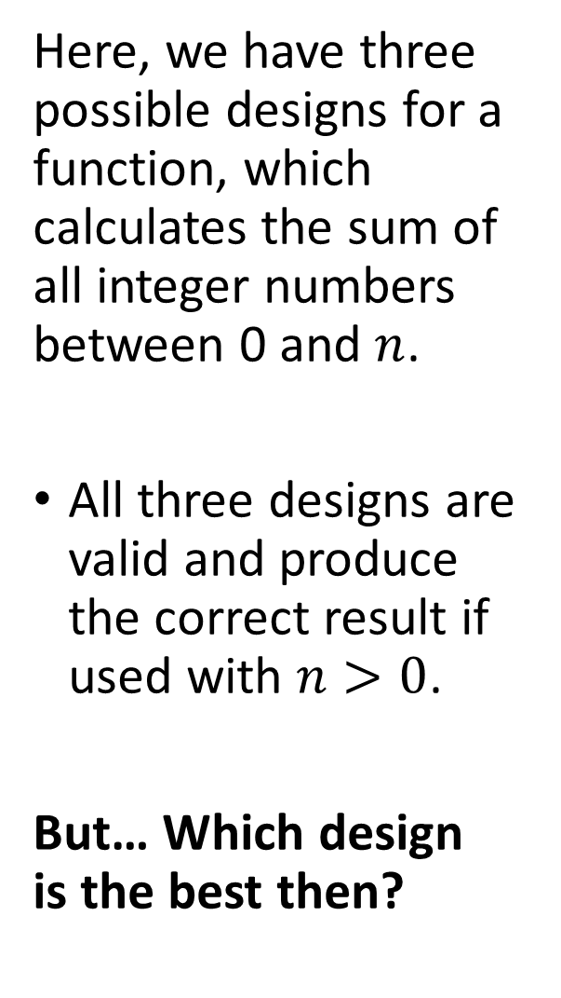
Here, we have three possible designs for a function, which calculates the sum of all integer numbers between 0 and $n$.
All three designs are valid and produce the correct result if used with $n>0$.
But… Which design is the best then?

Slide 18
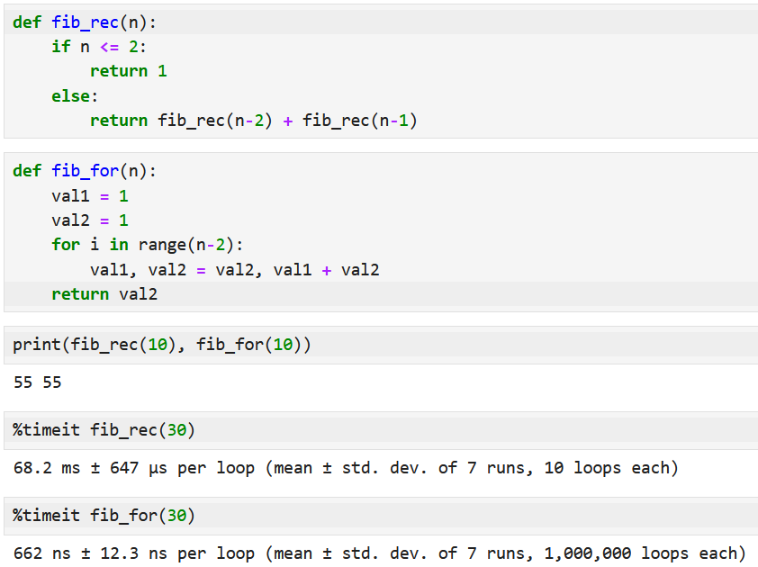
Which Fibonacci design was the best then?
The recursive design, while simpler in appearance, seems to be much slower…
Why is that?

Slide 19
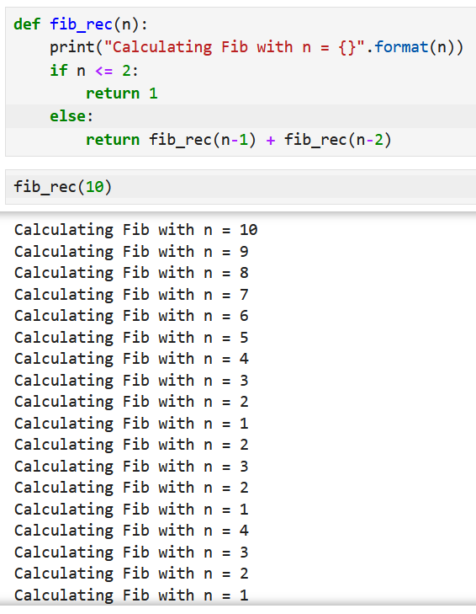
Which Fibonacci design was the best then?
The recursive design, while simpler in appearance, seems to be much slower…
Why is that?
The issue is that we recalculate the same Fibonacci numbers many times when using the recursion, which is very time consuming!

Slide 20
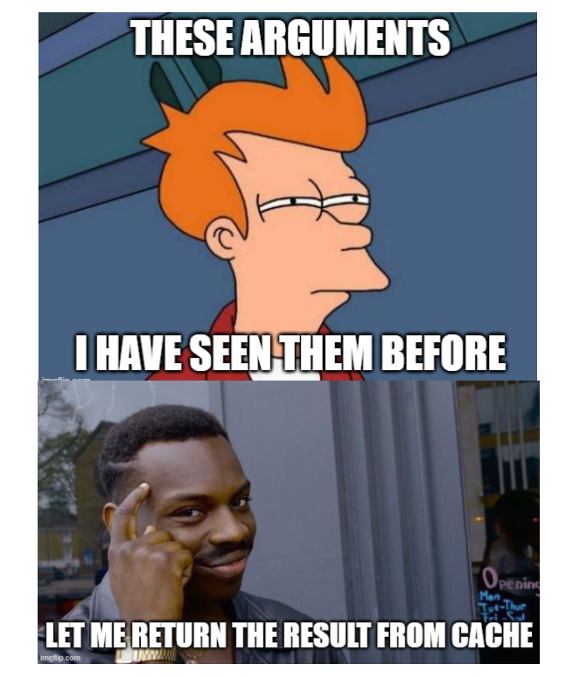
The LRU cache decorator (Memoization)
Definition (Memoization):
Memoization is an optimization technique used to speed up the execution of a (recursive) function. It can be particularly useful for functions with recursive or repetitive calls, which are re-computing the same result multiple time.
The idea is to remember/cache the results of expensive function calls and return the memorized result when the same inputs occur again.

Slide 21
The LRU cache decorator (Memoization)
Definition (Memoization):
Memoization is an optimization technique used to speed up the execution of a (recursive) function. It can be particularly useful for functions with recursive or repetitive calls, which are re-computing the same result multiple time.
The idea is to remember/cache the results of expensive function calls and return the memorized result when the same inputs occur again.
Memoization is easily done by using the LRU Cache decorator (@lru_cache) from the functools library!
(Note: functools is a standard Python library, which contains many decorators and functions you can use to pimp your functions! Read more, here: https://docs.python.org/3/library/functools.html)

Slide 22
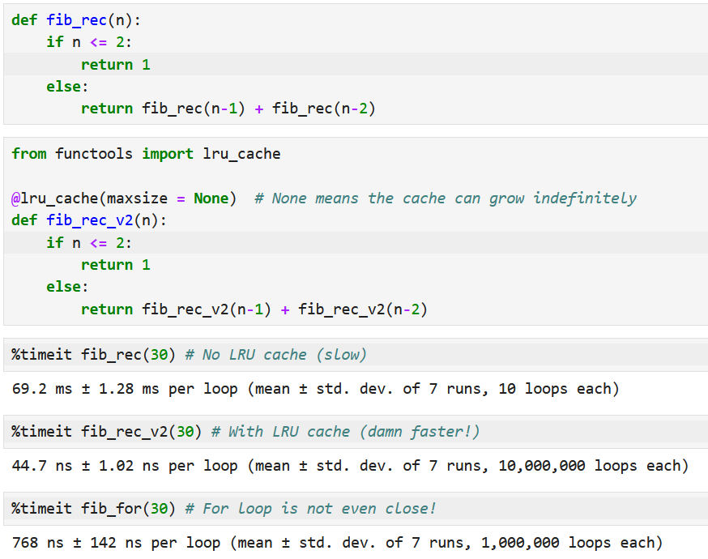
LRU cache makes the recursion much faster!

Slide 23

A quick word about decorators
Definition (Decorators):
Decorators are a powerful and flexible way to modify the behavior of functions without changing their actual code.
Decorators allow you to wrap another function and execute code before and/or after the wrapped function runs.
They are often used for tasks such as logging, timing, memoization, access control, and more.
FUNCTION

Slide 24
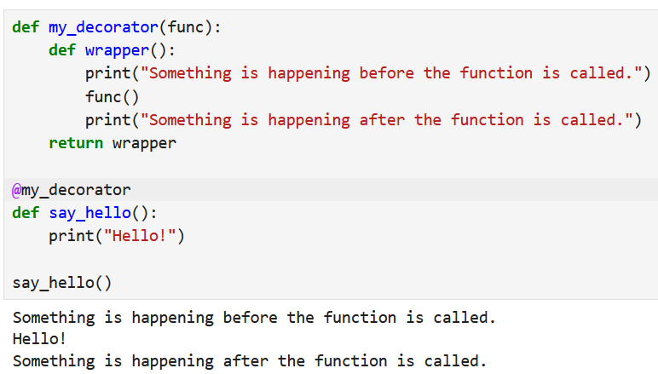
A quick word about decorators
Decorators require
A decorator function, which takes a function func as a parameter and contains another def statement for the wrapper function, inside.
Within this wrapper function, operations can occur before and/or after calls made using the function call func().
Later on, use the @ symbol and the name of your decorator on a third “decorated” function.
When running third function, the decorator/wrapper will execute its operations before and/or after the function call!

Slide 25
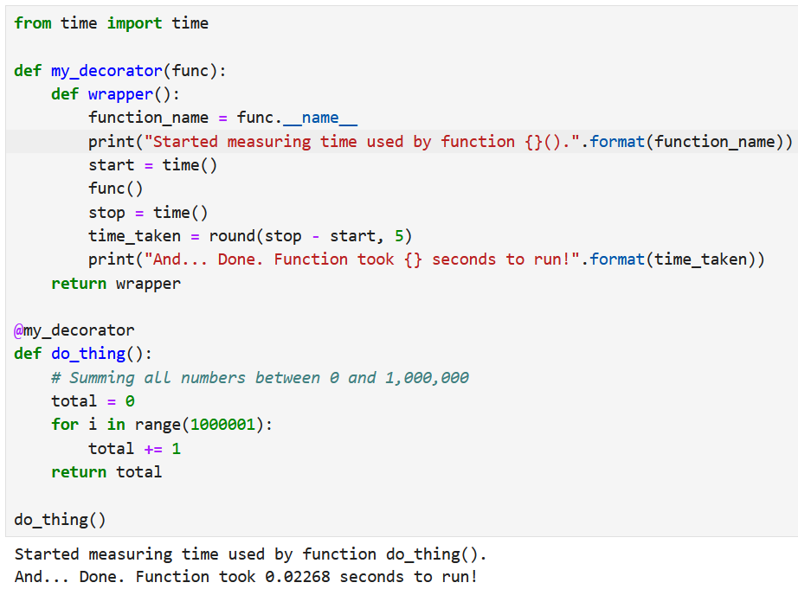
Using decorators to measure the time taken by your function runs!
For instance, we can use the time() function from the time library, which gives us a way to measure time…
And create a time measuring decorator to measure how much time our functions take to run!
Extremely useful to assess if one function design is better than another! (%timeit?)

Slide 26
Please download and install the Slido app on all computers you use
What will be printed?
ⓘ Start presenting to display the poll results on this slide.

Slide 27
Please download and install the Slido app on all computers you use
What will happen if a recursive function in Python does not have a base case?
ⓘ Start presenting to display the poll results on this slide.

Slide 28
Please download and install the Slido app on all computers you use
What to put in blank A and blank B to create a recursive function that sums elements of a list of integers?
ⓘ Start presenting to display the poll results on this slide.

Slide 29
Please download and install the Slido app on all computers you use
What will be printed here?
ⓘ Start presenting to display the poll results on this slide.

Slide 30
Please download and install the Slido app on all computers you use
Which of these two functions will be the fastest to compute the 50th Fibonacci number?
ⓘ Start presenting to display the poll results on this slide.

Slide 31
Just a few additional questions (For those looking for a challenge)
Some more practice for today: on for loops and recursion.
Easy challenge: What is, in fact, the fastest way to calculate the n-th Fibonacci number? (Recursion, Recursion with memoization, for loop, or… Something else?)
Difficult challenge: In the Extra Challenge folder of today’s lecture, an extra “difficult” challenge for you to try.

Slide 32
About daily coding activities
In fact, there are many websites out there who come up with daily coding activities (in the same way as the Wordle of the day).
Subscribe (free) and use them for extra practice!
Geeks4Geeks: https://www.geeksforgeeks.org/problem-of-the-day
W3Schools: https://www.w3schools.com/python/python_exercises.asp
FreeCodeCamp: https://www.freecodecamp.org/learn/daily-coding-challenge/archive
CodeWars: https://www.codewars.com/collections/daily-challenges
Etc.

Slide 33
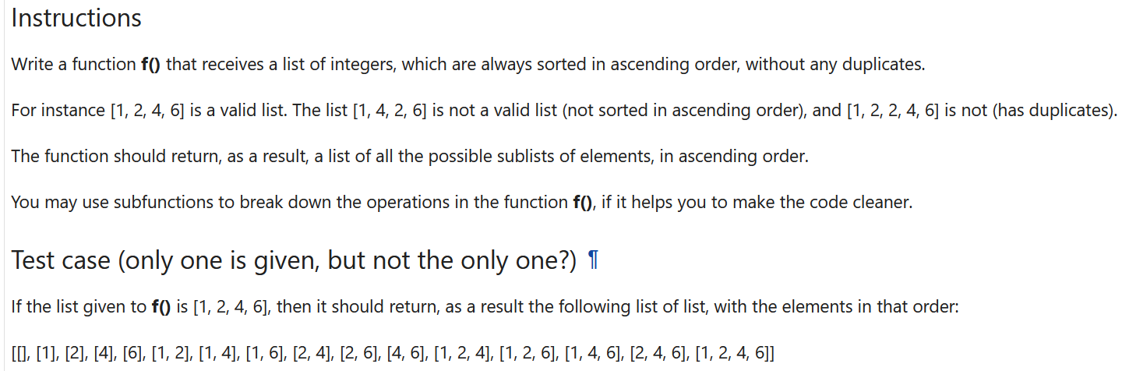
Finished everything and looking for a real challenge? (Finish the rest first!)
Easy challenge: What is, in fact, the fastest way to calculate the n-th Fibonacci number? (Recursion, Recursion with memoization, for loop, or… Something else?)
Difficult challenge: In the Extra Challenge folder of today’s lecture, an extra “difficult” challenge for you to try.

